Slide 1
Network meta-analysis: An introduction and applied example
Tim Disher, RN, Vanier Scholar
Co-Supervisors: Dr. Marsha Campbell-Yeo, Dr. Ruth Martin-Misener
Contact Information:
Tim.disher@dal.ca

Slide 2
Network Meta-analysis primer
Notes:
Part of Coursework

Slide 3
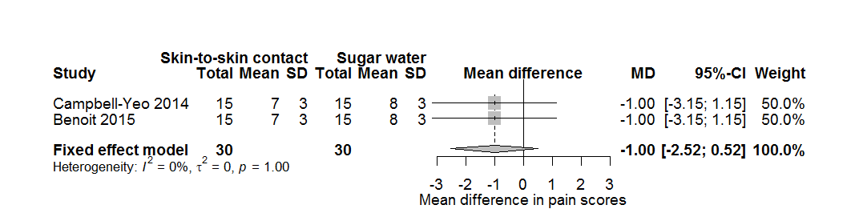
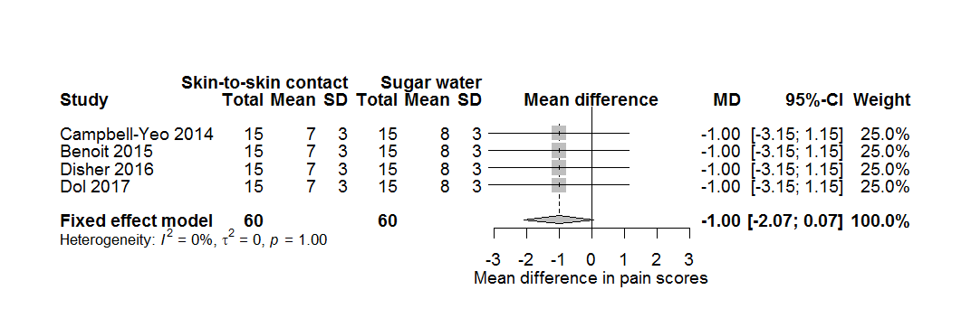
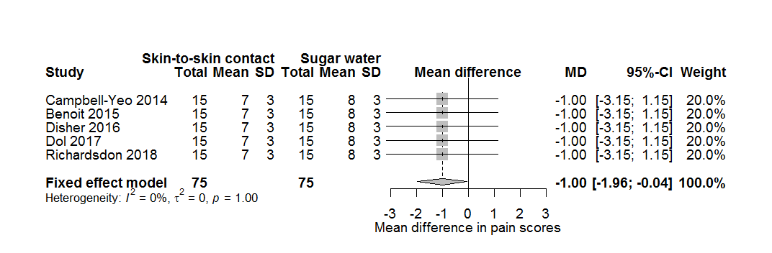
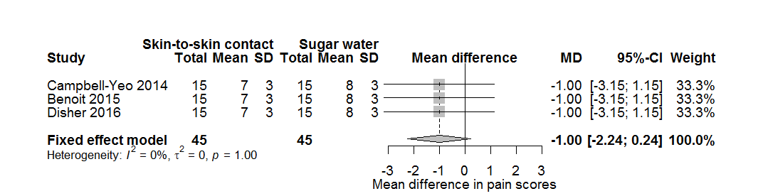
WHY CONDUCT A META-ANALYSIS?
NMA PRIMER
Borenstein, Hedges, Higgins, & Rothstein, 2009

Slide 4
WHAT IF HAD A DIFFERENT QUESTION?
NMA PRIMER
Skin to Skin
Breastfeeding
Sweet taste
Notes:
Arrow for direct and indirect

Slide 5
DIRECT AND INDIRECT EVIDENCE
NMA PRIMER
Skin to Skin
Breastfeeding
Sweet taste
Notes:
Arrow for direct and indirect

Slide 6
DIRECT AND INDIRECT EVIDENCE
NMA PRIMER
Skin to Skin
Breastfeeding
DIRECT EVIDENCE
Sweet taste
Notes:
Arrow for direct and indirect

Slide 7
DIRECT AND INDIRECT EVIDENCE
NMA PRIMER
Skin to Skin
INDIRECT EVIDENCE
Breastfeeding
DIRECT EVIDENCE
Sweet taste
Notes:
Arrow for direct and indirect

Slide 8
DIRECT AND INDIRECT EVIDENCE
NMA PRIMER
Skin to Skin
INDIRECT EVIDENCE
Breastfeeding
DIRECT EVIDENCE
Sweet taste
Notes:
Arrow for direct and indirect

Slide 9
ASSUMPTIONS
NMA PRIMER
Skin to Skin
Similar to pairwise meta-analysis
Trials are similar with respect to
distribution of effect modifiers
Terminology:
Transitivity
Clinical judgement
Consistency
Formal tests
Breastfeeding
Sweet taste
Dias, Sutton, Ades, & Welton, 2013

Slide 10
WHAT CAN NMA ADD?
NMA PRIMER
Rigorous comparison of all available interventions
Explicit assessment of transitivity/consistency
Appropriate treatment of multi-arm trials
Improved precision (sometimes)
More opportunities to explore sources of heterogeneity
Guidance for future research that incorporates entire evidence base
Dias, Sutton, Ades, & Welton, 2013

Slide 11
Basic steps in an NMA
NMA PRIMER
Systematic review
Quality appraisal
Network visualization
Synthesis feasibility
Pairwise meta-analysis
NMA
Exploring heterogeneity
Drawing conclusions
Dias, Sutton, Ades, & Welton, 2013

Slide 12
TWO MAIN APPROACHES
NMA PRIMER
NMAs can be conducted using traditional (using R or STATA) or Bayesian methods
Advantages of Bayesian methods
Allow probabilistic statements (e.g. probability an intervention is best)
Logical interpretation of coverage intervals
Theoretically superior treatment of between-trial heterogeneity
Increased flexibility
More robust against zero cells
Disadvantages of Bayesian methods
Time, need to run additional diagnostics
Random effects can “explode” with insufficient data
Requires strong statistical programming skills
Dias, Sutton, Ades, & Welton, 2013

Slide 13
Applied example: Pain reducing treatments for retinopathy of prematurity eye exams
Notes:
Part of Coursework

Slide 14
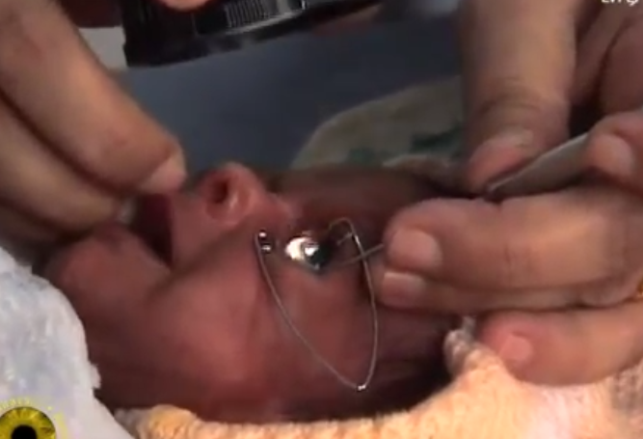
SCREENING FOR ROP
BACKGROUND
Canadian Paediatric Society guidelines recommend serial eye exams for all infants born less than 31 weeks GA as well as infants less than 1250g. Canadian Paediatric Society, 2016
Standard approach includes the use of speculum and scleral depression.
Notes:
Part of Coursework

Slide 15
REVIEW QUESTION
WHAT IS THE MOST EFFECTIVE PAIN RELIEVING STRATEGY FOR EYE EXAMS IN PRETERM NEONATES?
Notes:
Part of Coursework

Slide 16
METHODS
BAYESIAN NETWORK META-ANALYSIS
P | Preterm infants undergoing ROP eye exam in the Neonatal intensive care unit (NICU)
I | Procedure modification or Pharmacological or non-pharmacological pain relieving treatments
C | Active treatment or placebo
O | Primary: Validated pain assessment tools during (pain reactivity) and immediately after (pain regulation) eye exams. If multiple timepoints reported, closest to start/end of procedure used. Secondary: Physiological, behavioural, and adverse event outcomes
S | Randomized controlled trials including crossovers
Notes:
Part of Coursework

Slide 17
STATISTICAL ANALYSIS
METHODS
Consistency assessed using node splitting and supplemented with consistency model. Dias, Sutton, Ades, & Welton, 2013
Meta-regression based on: baseline risk, scaled score, imputed mean, birthweight, gestational age, risk of bias
Model fit assessed following NICE recommendations
Notes:
Part of Coursework

Slide 18
STATISTICAL ANALYSIS
METHODS
Pain reactivity and regulation converted to absolute scores using the largest trial as a baseline. Dias, Sutton, Ades, & Welton, 2013; Thorlund, Walter, Johnston, Furukawa, & Guyatt, 2011
Used to create icon arrays for top three treatments as ranked by SUCRA
Calculate probability that absolute score is below a threshold
Notes:
Part of Coursework

Slide 19
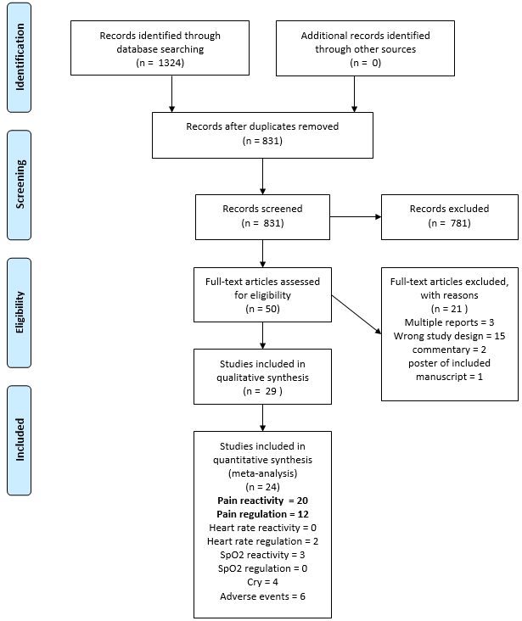
RESULTS

Slide 20
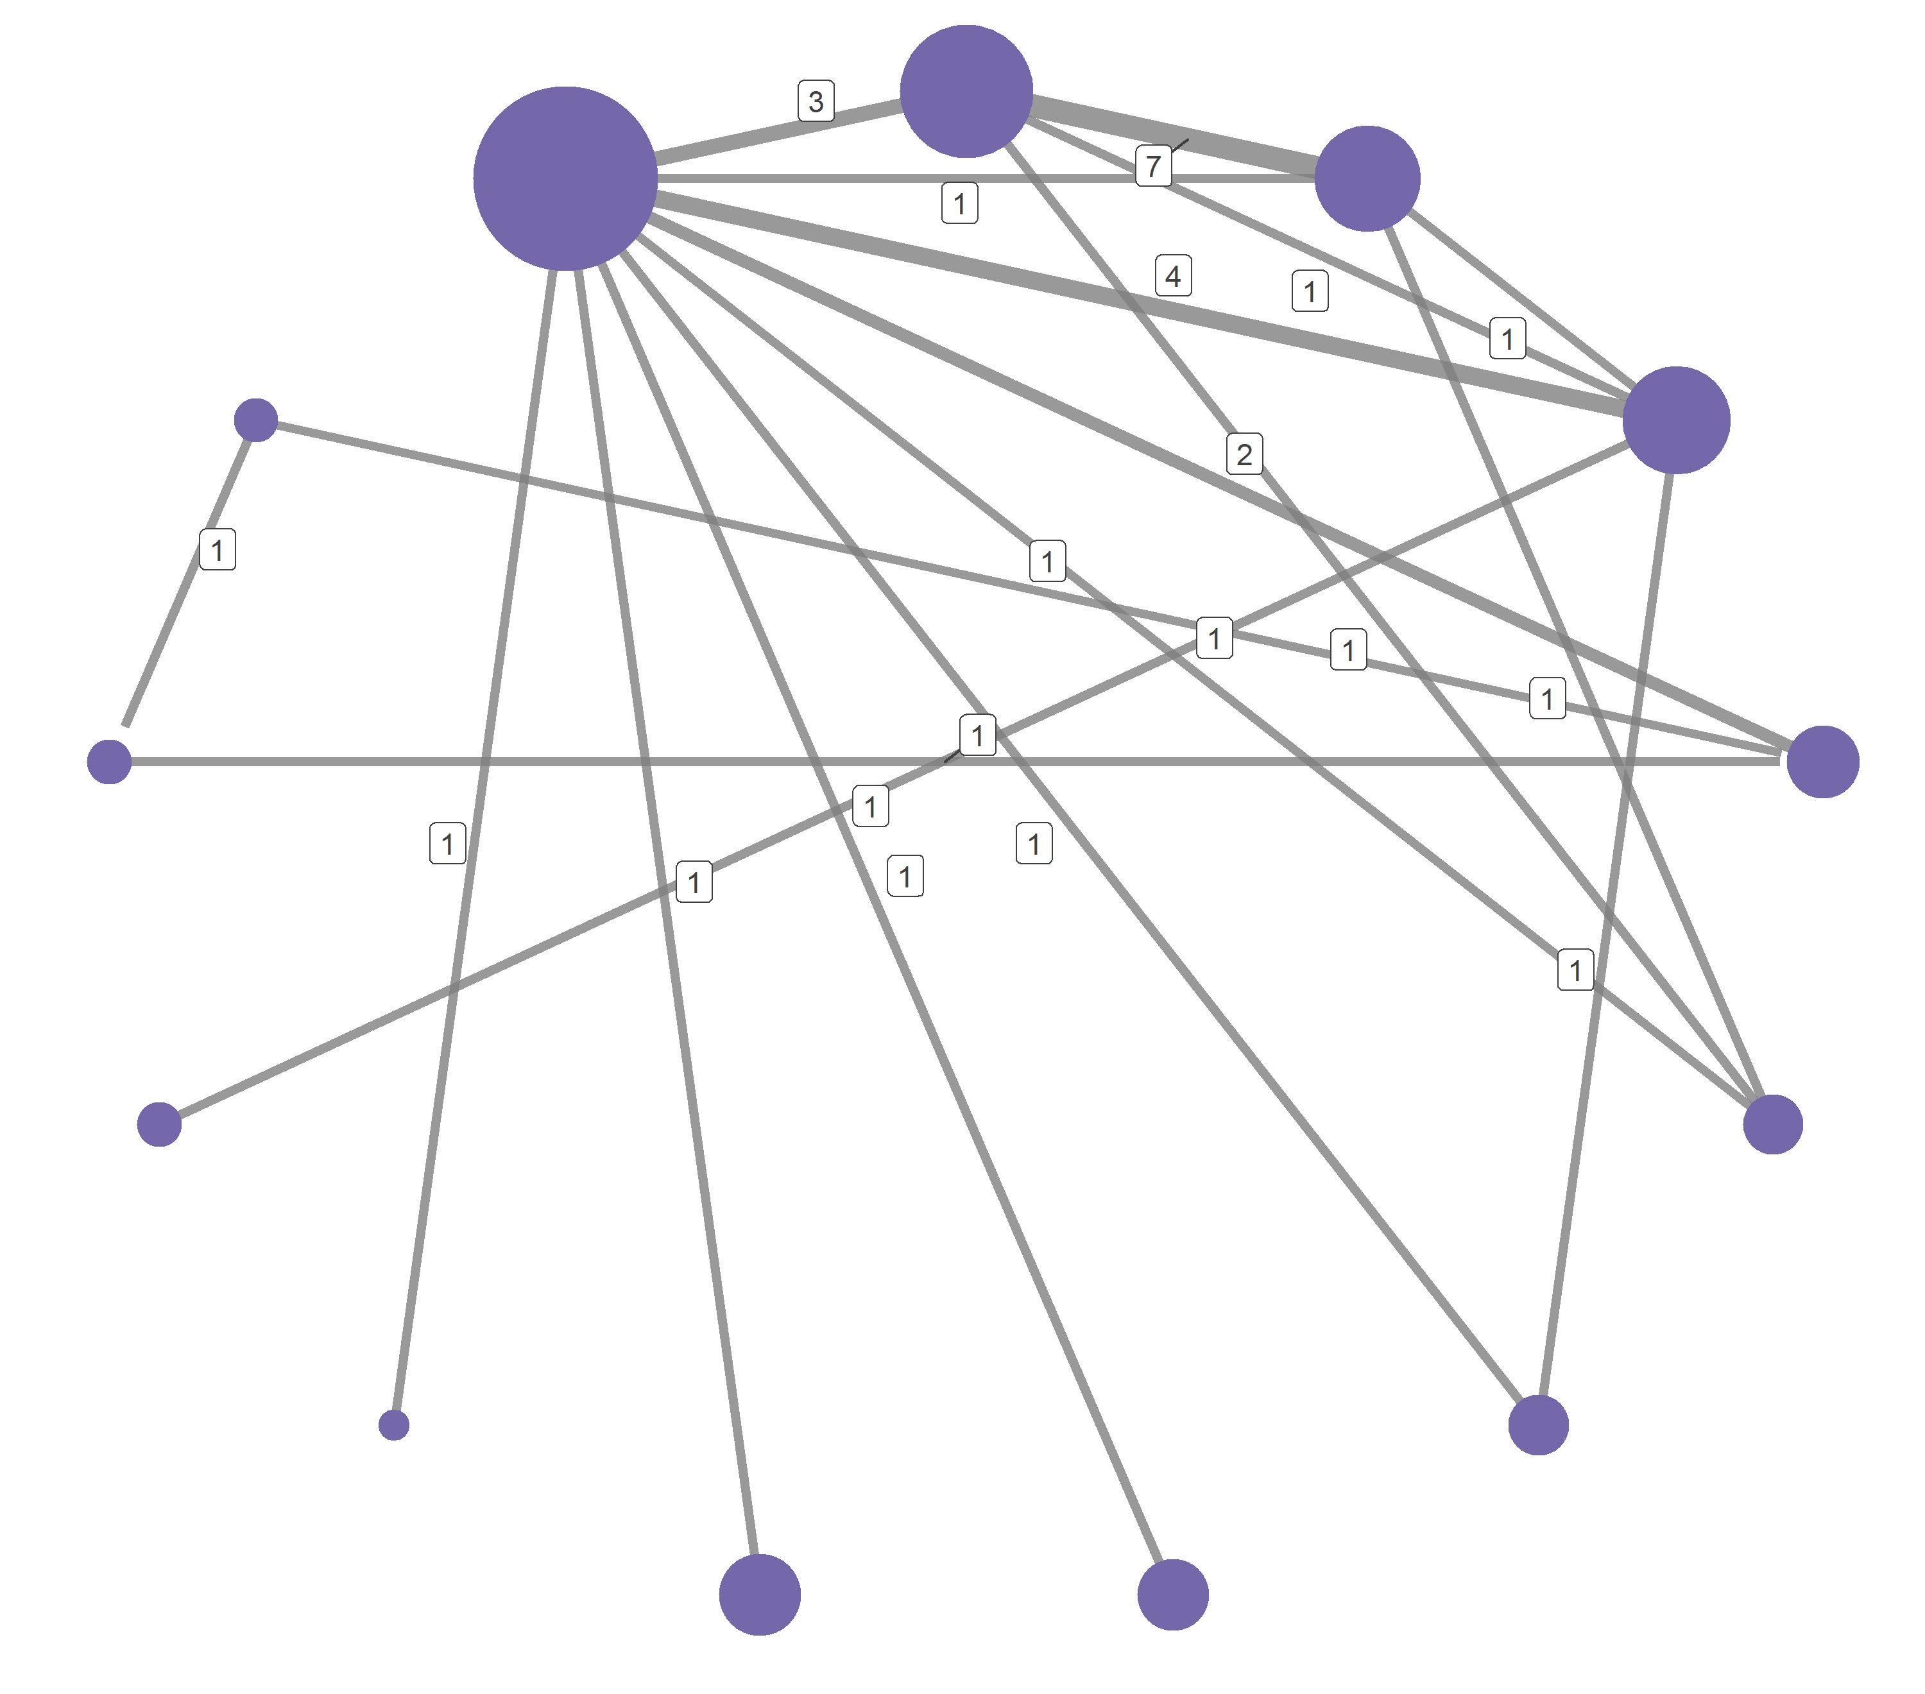
RESULTS – PAIN REACTIVITY
Sweet taste multisensory + TA
Topical Anesthetic (TA)
NNS + TA
Sweet + singing
Sweet taste + TA
PAIN REACTIVITY
Sweet repeated
No treatment
Sweet taste + N2O + TA
EBM multisensory + TA
Sweet taste
Acetaminophen 30m + TA
WFDRI + TA
Acetaminophen 60m + TA
Notes:
20 studies (n = 1228) with data that could be included in meta-analysis
13 treatments

Slide 21
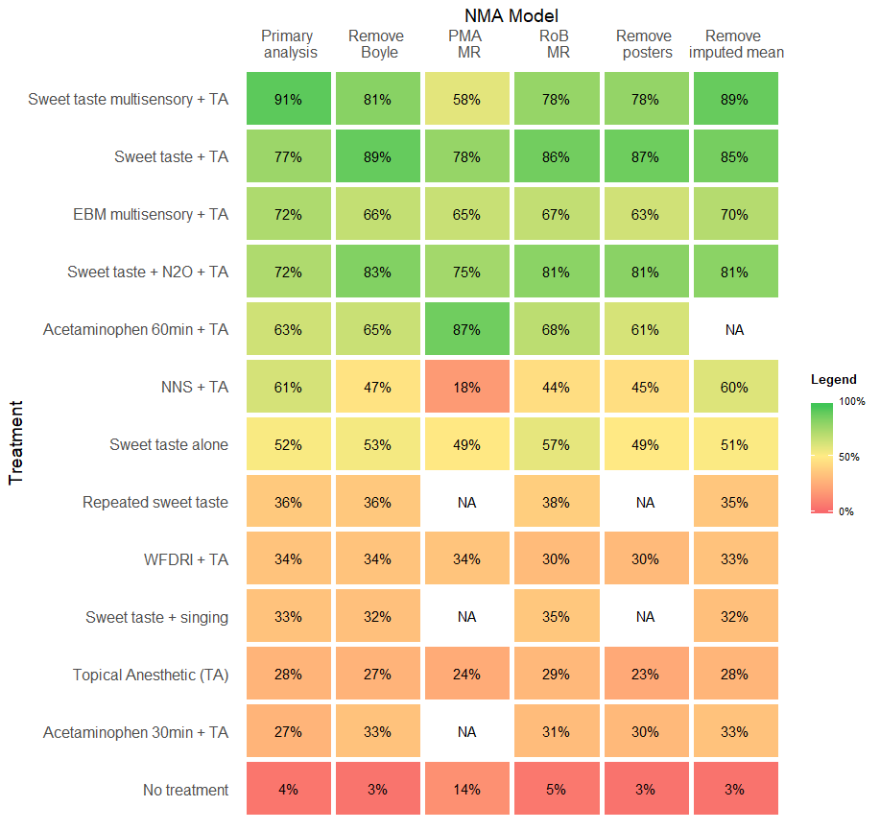
RESULTS – PAIN REACTIVITY
Inconsistency detected in one comparison.
Trial was very high risk of bias and inaccessible to meta-regression
Removal reduced between-trial SD
Best fitting model was Boyle removed and imputed means removed
nStud = 20
N = 1228
SD = 1.32
nStud = 19
N = 1188
SD = 1.15
nStud = 14
N = 809
SD = 0.78
nStud = 19
N = 1188
SD = 1.21
nStud = 17
N = 1084
SD = 1.21
nStud = 16
N = 966
SD = 1.09
INCONSISTENCY

Slide 22
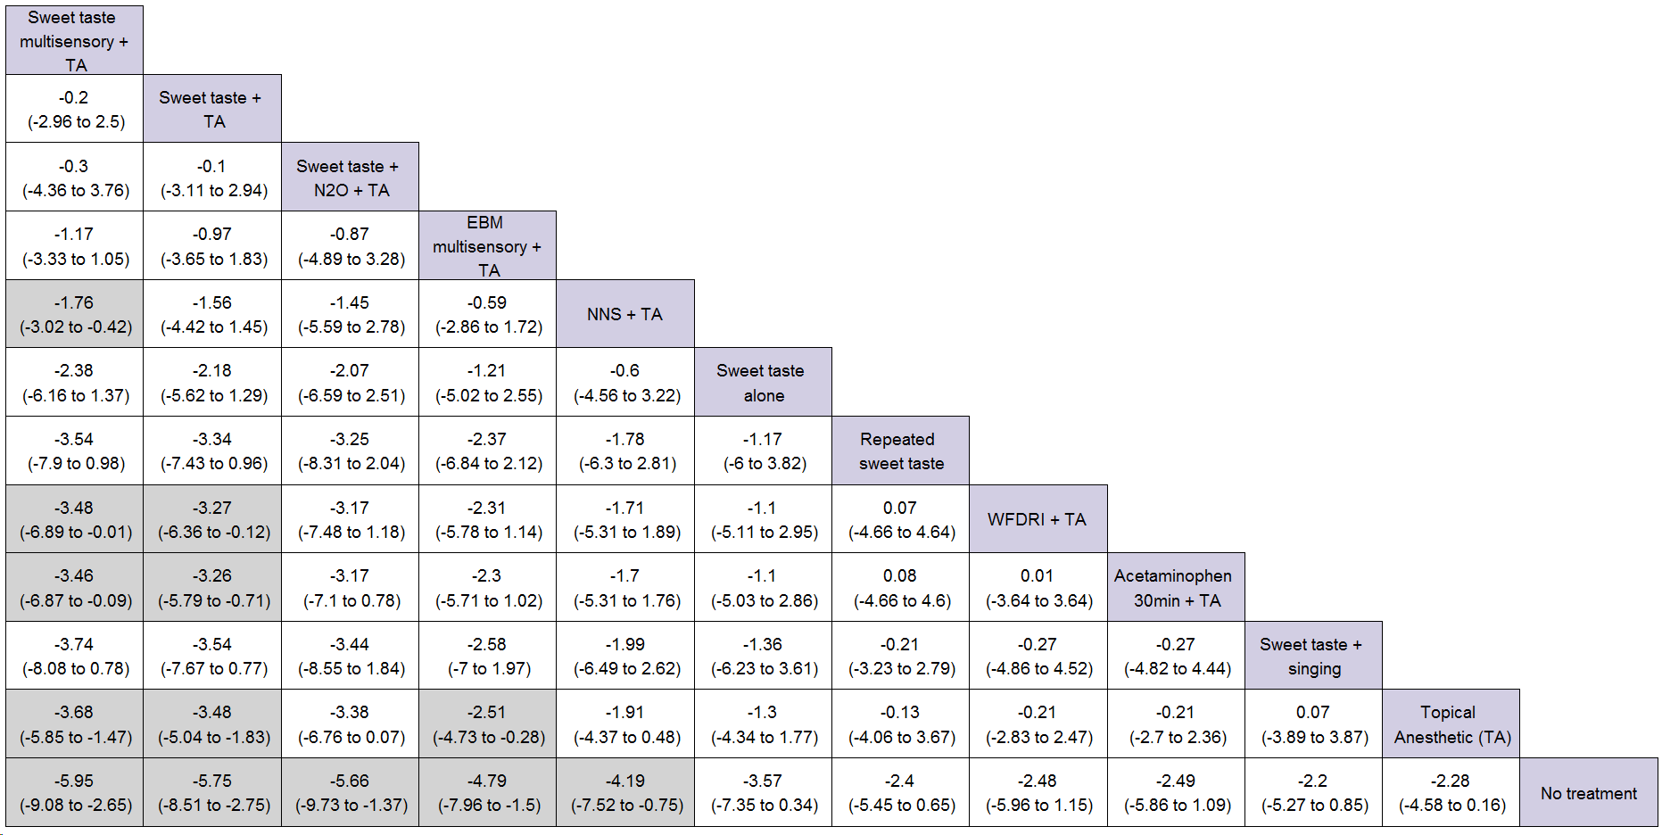
League table (all comparisons)
RESULTS – PAIN REACTIVITY
Moderate heterogeneity
Probability that difference between top two treatments is at least 2 points = 12.8%
RELATIVE EFFECTS

Slide 23
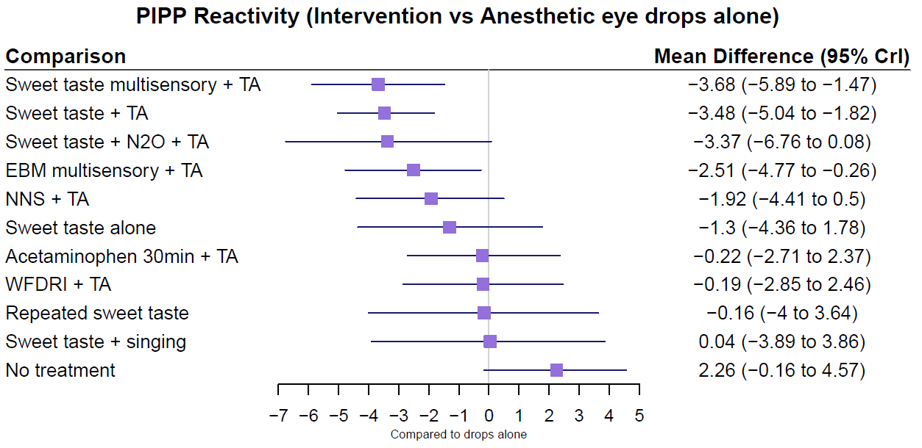
PIPP Reactivity vs Topical Anesthetic
RESULTS – PAIN REACTIVITY
Moderate heterogeneity
Probability that difference between top two treatments is at least 2 points = 12.8%
RELATIVE EFFECTS

Slide 24
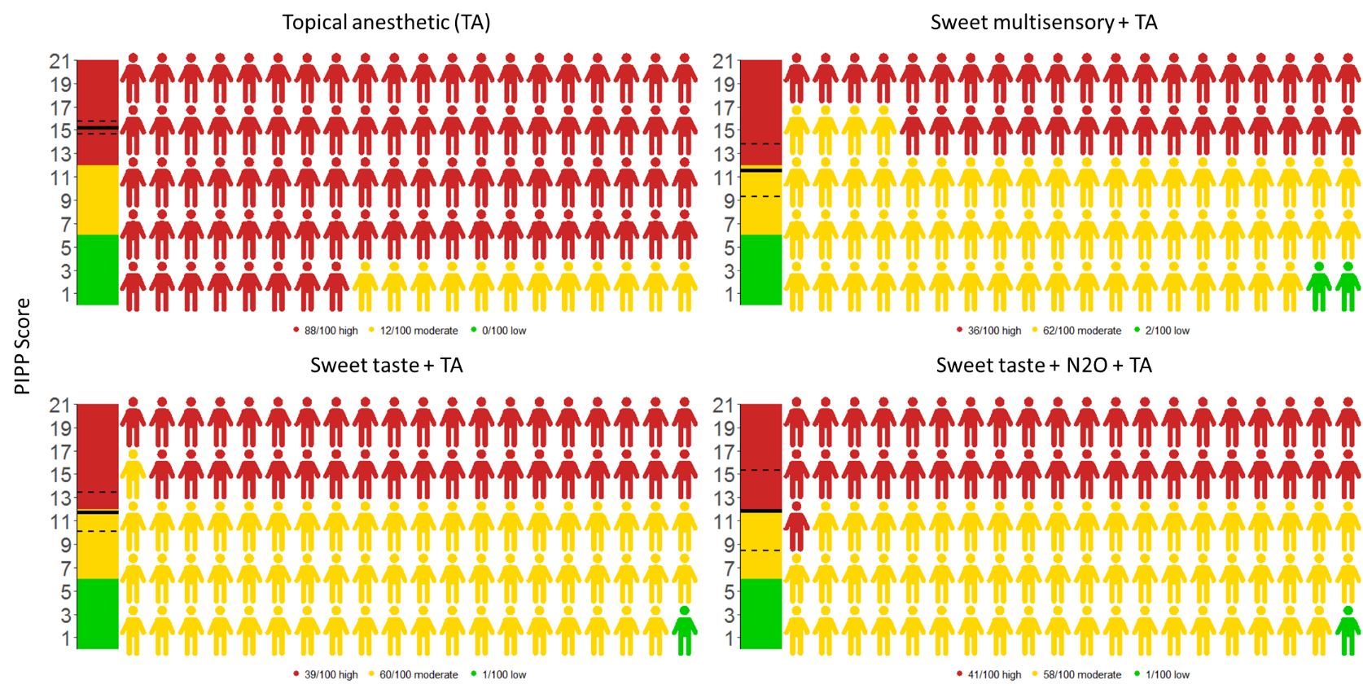
RESULTS – PAIN REACTIVITY
Probability that mean absolute score <= 6 less than 1%
ABSOLUTE SCORES
PIPP Score

Slide 25
CONCLUSIONS
DISCUSSION – IMPLICATIONS – AND CONCLUSIONS
“Best” treatment most likely to be sweet taste combined with other sensory stimulation
Little justification to choose between top treatments
No treatments appear effective in absolute terms.
Need to identify sources of heterogeneity

Slide 26
REFERENCES
Borenstein, M., Hedges, L. V., Higgins, J. P. T., & Rothstein, H. R. (2009). Introduction to Meta-Analysis. https://doi.org/10.1002/9780470743386.fmatter
Dias, S., Sutton, A. J., Ades, A. E., & Welton, N. J. (2013). Evidence Synthesis for Decision Making 2: A Generalized Linear Modeling Framework for Pairwise and Network Meta-analysis of Randomized Controlled Trials. Medical Decision Making, 33(5), 607. https://doi.org/10.1177/0272989X12458724
Dias, S., Welton, N. J., Sutton, A. J., Caldwell, D. M., Lu, G., & Ades, a E. (2013). Evidence synthesis for decision making 4: inconsistency in networks of evidence based on randomized controlled trials. Medical Decision Making : An International Journal of the Society for Medical Decision Making, 33(5), 641–56. https://doi.org/10.1177/0272989X12455847
Francis, K. (2016). Evidence-Based Practice Brief What Is Best Practice for Providing Pain Relief During Retinopathy of Prematurity, 16(3), 220–228. https://doi.org/10.1097/ANC.0000000000000267
Higgins, J. P. T., & Green, S. (2011). Cochrane Handbook for Systematic Reviews of Interventions (Version 5.). The Cochrane Collaboration. Retrieved from www.cochrane-handbook.org
Jefferies, A., & Canadian Paediatric Society: Fetus and Newborn Committee. (2016). Retinopathy of prematurity: An update on screening and management. Paediatr Child Health, 21(2), 101–4. https://doi.org/10.1016/s0031-3955(02)00111-6
Samra, H. a, & McGrath, J. M. (2009). Pain management during retinopathy of prematurity eye examinations: a systematic review. Advances in Neonatal Care : Official Journal of the National Association of Neonatal Nurses, 9(3), 99–110. https://doi.org/10.1097/ANC.0b013e3181a68b48
Shah, P., Yoon, E. W., & Chan, P. (2014). Annual Report 2014. Canadian Neonatal Network.
Stevens, B., Yamada, J., Ohlsson, A., Haliburton, S., & Shorkey, A. (2016). Sucrose for analgesia in newborn infants undergoing painful procedures. In J. Yamada (Ed.), Cochrane Database of Systematic Reviews (Vol. 1, p. CD001069). Chichester, UK: John Wiley & Sons, Ltd. https://doi.org/10.1002/14651858.CD001069.pub5
Sun, X., Lemyre, B., Barrowman, N., & O’Connor, M. (2010). Pain management during eye examinations for retinopathy of prematurity in preterm infants: A systematic review. Acta Paediatrica, International Journal of Paediatrics, 99(3), 329–334. https://doi.org/10.1111/j.1651-2227.2009.01612.x
Thorlund, K., Walter, S. D., Johnston, B. C., Furukawa, T. A., & Guyatt, G. H. (2011). Pooling health-related quality of life outcomes in meta-analysis-a tutorial and review of methods for enhancing interpretability. Research Synthesis Methods, 2(3), 188–203. https://doi.org/10.1002/jrsm.46

Slide 27

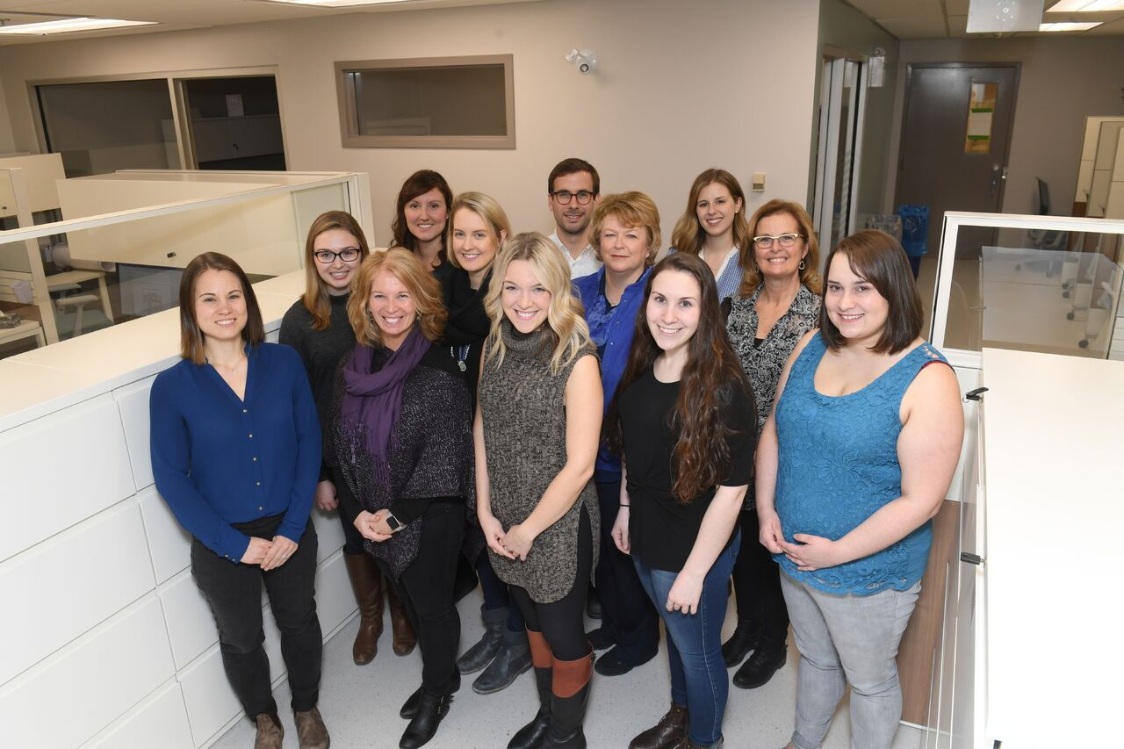



Acknowledgements
Special thanks to the MOM-LINC lab and funders for ongoing support

Slide 28
Extra slides

Slide 29
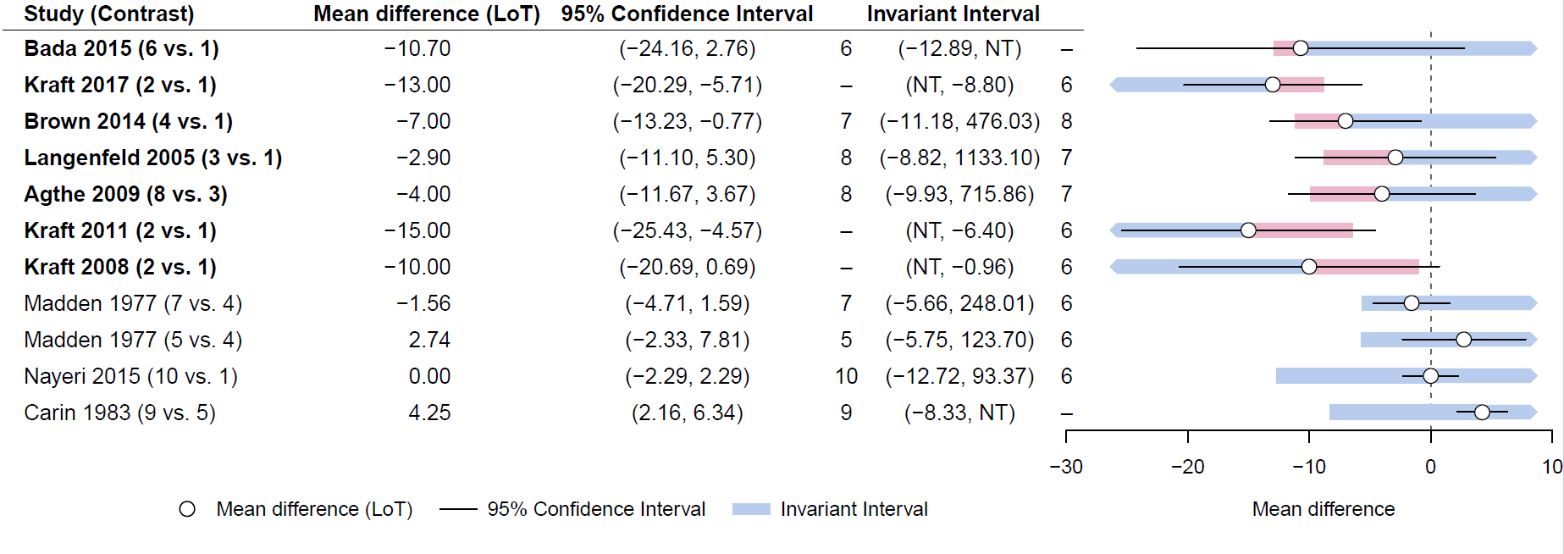
Identifying influential studies

Slide 30
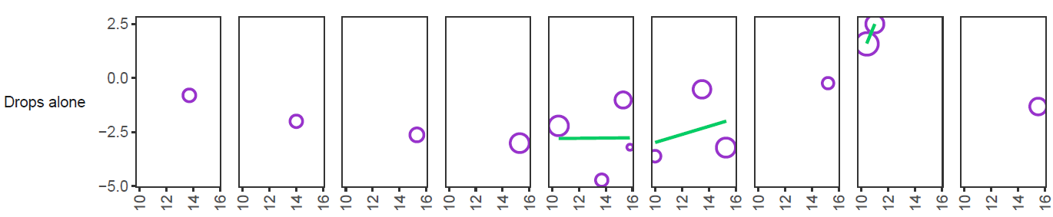
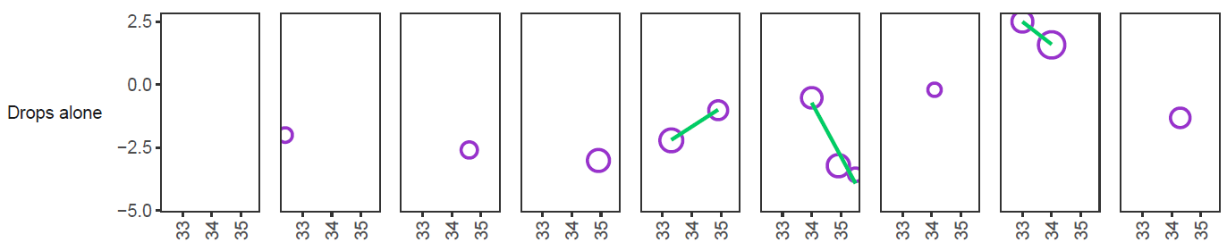
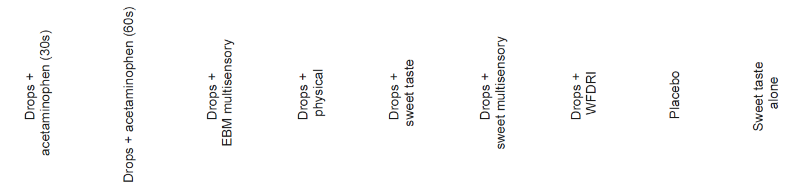
Participant characteristics
RESULTS – PAIN REACTIVITY
SYNTHESIS FEASIBILITY
Treatment effect
Baseline PIPP score
Postmenstrual age

Slide 31
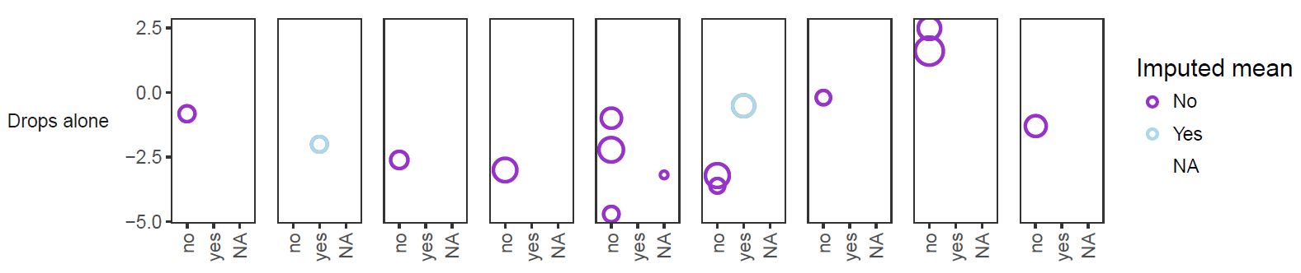
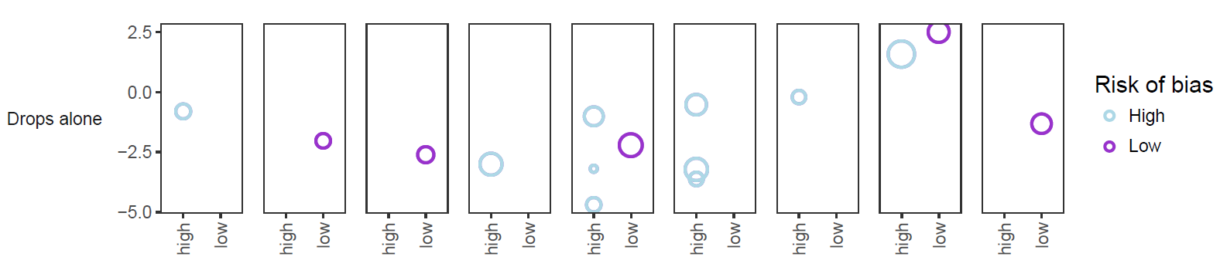
Study Characteristics
RESULTS – PAIN REACTIVITY
SYNTHESIS FEASIBILITY
Imputed mean
Treatment effect
Risk of Bias

